Slide 1


Department of CSE
DESIGN AND ANALYSIS OF ALGORITHMS
24CS2203
Topic:
Divide and Conquer
Quick Sort

Slide 2
Quick sort
Quick sort
Quick Sort is a Divide and Conquer algorithm.
It picks an element as pivot and partitions the given array around the picked pivot.
There are many different versions of quick sort that pick pivot in different ways.
  Always pick first element as pivot.
  Always pick last element as pivot
  Pick a random element as pivot.
  Pick median as pivot.
Best case | O(nlogn)
Average case | O(nlogn)
Worst case | O(n^2)
Memory | Average: logn Worst: n
Stable | NO
Inplace | Yes

Slide 3
Quick sort algorithm
Step 1 − Choose the highest index value has pivot
Step 2 − Take two variables to point left and right of the list excluding pivot
Step 3 − left points to the low index -1
Step 4 − right points to the high
Step 5 − while value at left is less than pivot move right
Step 6 − while value at right is greater than pivot move left
Step 7 − if both step 5 and step 6 does not match swap left and right
Step 8 − if left ≥ right, the point where they met is new pivot

Slide 4
EXAMPLE
List partition
5 | 3 | 8 | 1 | 4 | 6 | 2 | 7
P
L
R
5 | 3 | 8 | 1 | 4 | 6 | 2 | 7
P
L
R
5 | 3 | 8 | 1 | 4 | 6 | 2 | 7
P
L
R
5 | 3 | 8 | 1 | 4 | 6 | 2 | 7
P
L
SWAP ARR[L] = ARR[R]
R

Slide 5
5 | 3 | 2 | 1 | 4 | 6 | 8 | 7
P
L
R
5 | 3 | 2 | 1 | 4 | 6 | 8 | 7
P
L
R
5 | 3 | 2 | 1 | 4 | 6 | 8 | 7
P
L
R
5 | 3 | 2 | 1 | 4 | 6 | 8 | 7
P
L
R

Slide 6
5 | 3 | 2 | 1 | 4 | 6 | 8 | 7
P
L
R
5 | 3 | 2 | 1 | 4 | 6 | 8 | 7
P
R crossed L
SWAP ARR[R] = ARR[P]
R
L
4 | 3 | 2 | 1 | 5 | 6 | 8 | 7
P
L
R
P
L
R
The same steps are repeated on the left and right parts of the list.

Slide 7
Time complexity
Best case: The pivot chosen always divides the array into two equal halves.
Average case: The pivot divides the array into two subarrays that are not necessarily equal but reasonably balanced.
Worst case: The pivot chosen is always the smallest or largest element, leading to highly unbalanced partitions.

Slide 8
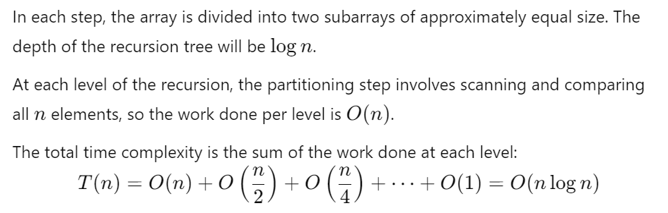
Best case

Slide 9
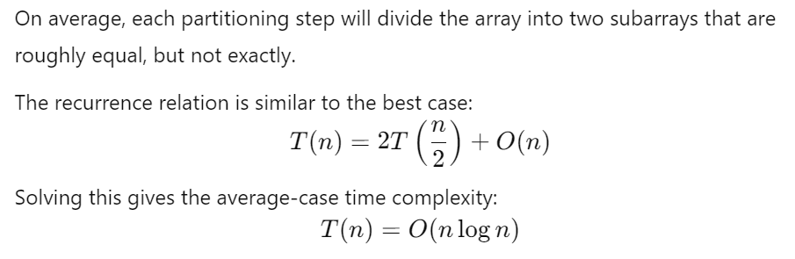
Average case

Slide 10
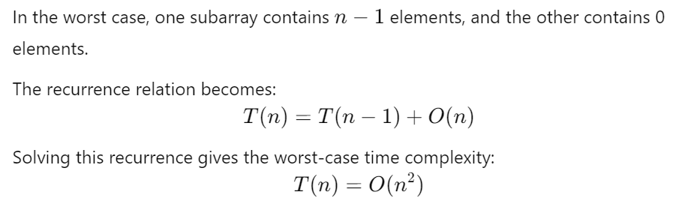
Worst case

Slide 11
Examples
Sort the following elements using Quick sort technique using first element as pivot: 54, 26, 93, 17, 77, 31, 44, 55, 20
Sort the following elements using Quick sort technique using last element as pivot: 10, 80, 30, 90, 40, 50, 70, 60
8,7,1,2,6,9,10,2,11 sort using the last element as pivot.

